Slide 1


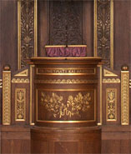
CSR5: An Efficient Storage Format for Cross-Platform Sparse Matrix-Vector Multiplication Weifeng Liu, Brian Vinter Niels Bohr Institute, University of Copenhagen, Denmark

Slide 2
Sparse Matrix & Sparse Matrix-Vector Multiplication (SpMV)
Faculty of Science

Slide 3
Sparse Matrix
If the majority of entries in a matrix are zeros, we can store the matrix using a sparse representation that only records nonzero entries.
0
0
0
1
0
0
1
row index =
0
1
1
3
3
3
0
2
0
3
0
0
0
2
0
3
column index =
2
0
1
0
2
3
0
0
0
0
0
4
0
0
5
0
6
0
4
0
5
0
6
value =
0
1
0
2
0
3
0
4
0
5
0
6
A
(4x4)
dense
A
(4x4)
nnzA = 6
A (a sparse representation)
(4x4)
nnzA = 6

Slide 4
Sparse Matrix-Vector Multiplication
Multiply a sparse matrix A by a dense vector x, obtain a dense vector y.
0
1
x
0
a
=
1c
0
2
0
3
0
b
2a+3b
0
c
0
0
4
0
5
0
6
0
d
4a+5c+6d
A
(4x4)
nnzA = 6
x
(4x1)
dense
y
(4x1)
dense
Storage format of A is crucial for SpMV throughput.

Slide 5
Storage format – Diagonal (DIA)
Store nonzero entries on diagonals.
0
1
0
2
0
3
0
4
diagonal (0) =
0
1
0
2
0
3
0
4
0
5
0
0
6
5
0
6
A
(6x6)
nnzA = 6
A (in DIA format)
(6x6)
nnzA = 6

Slide 6
Storage format – Diagonal (DIA)
Store nonzero entries on diagonals.
0
1
0
7
0
12
0
2
0
8
diagonal (-1) =
0
0
12
0
13
0
14
0
15
0
16
0
13
0
3
0
9
diagonal (0) =
0
1
0
2
0
3
0
4
0
5
0
6
0
14
0
4
0
10
diagonal (+1) =
0
7
0
8
0
9
0
10
0
0
11
0
15
0
5
0
11
0
16
0
6
A
(6x6)
nnzA = 16
A (in DIA format)
(6x6)
nnzA = 16

Slide 7
Storage format – Diagonal (DIA)
Store nonzero entries on diagonals.
diagonal (-2) =
0
0
0
0
18
0
0
0
1
0
7
0
12
0
2
0
8
diagonal (-1) =
0
0
12
0
13
0
14
0
15
0
16
0
18
0
13
0
3
0
9
diagonal (0) =
0
1
0
2
0
3
0
4
0
5
0
6
0
14
0
4
0
10
0
17
diagonal (+1) =
0
7
0
8
0
9
0
10
0
0
11
0
15
0
5
0
11
0
16
0
6
diagonal (+2) =
0
0
0
0
0
0
17
A
(6x6)
nnzA = 18
A (in DIA format)
(6x6)
nnzA = 18

Slide 8
Storage format – ELLPACK (ELL)
Store nonzero entries and their column indices.
column index =
value =
0
1
0
7
0
1
-
-
0
1
0
7
0
0
0
12
0
2
0
8
0
1
2
-
0
12
0
2
0
8
0
0
18
0
13
0
3
0
9
0
1
2
3
0
18
0
13
0
3
0
9
0
14
0
4
0
10
0
17
2
3
4
5
0
14
0
4
0
10
0
17
0
15
0
5
0
11
3
4
5
-
0
15
0
5
0
11
0
0
16
0
6
4
5
-
-
0
16
0
6
0
0
A
(6x6)
nnzA = 18
A (in ELL format)
(6x6)
nnzA = 18

Slide 9
Storage format – ELLPACK (ELL)
Store nonzero entries and their column indices.
column index =
value =
-
-
-
-
0
0
0
0
-
-
-
-
0
0
0
0
0
18
0
13
0
3
0
9
0
1
2
3
0
18
0
13
0
3
0
9
-
-
-
-
0
0
0
0
-
-
-
-
0
0
0
0
-
-
-
-
0
0
0
0
A
(6x6)
nnzA = 4
A (in ELL format)
(6x6)
nnzA = 4

Slide 10
Storage format – Coordinate (COO)
Store nonzero entries and their row and column indices.
0
1
0
8
row index =
0
1
2
2
2
2
5
5
0
18
0
13
0
3
0
9
column index =
0
2
0
1
2
3
4
5
value =
0
1
0
8
0
18
0
13
0
3
0
9
0
16
0
6
0
16
0
6
A
(6x6)
nnzA = 8
A (in COO format)
(6x6)
nnzA = 8

Slide 11
Storage format – Compressed Sparse Row (CSR)
Store a row pointer, nonzero entries and their column indices.
0
1
row pointer =
0
1
2
6
6
6
8
0
8
0
18
0
13
0
3
0
9
column index =
0
2
0
1
2
3
4
5
value =
0
1
0
8
0
18
0
13
0
3
0
9
0
16
0
6
0
16
0
6
A
(6x6)
nnzA = 8
A (in CSR format)
(6x6)
nnzA = 8

Slide 12
CSR-based SpMV
assign a row block (multiple rows) to one core.
0
1
Core 0
0
8
Core 1
Possibly
imbalanced
computation
0
18
0
13
0
3
0
9
Core 2
Core 3
Core 4
0
16
0
6
Core 5
A
(6x6)
nnzA = 8

Slide 13
The CSR5 Storage Format (this work)
Faculty of Science

Slide 14
CSR5: Tiling
column index =
Core 0
Core 1
Tile 0
for
core 0
Tile 1
for
core 1
0
7
1
6
5
2
6
2
6
7
2
1
2
7
0
3
7
3
3
3
3
1
1
4
0
4
0
1
0
2
0
3
0
4
0
5
6
0
4
3
1
5
1
5
0
1
0
2
value =
0
1
0
5
0
2
0
6
0
3
0
2
0
6
0
3
0
7
0
8
0
1
0
2
0
3
0
4
0
5
0
6
0
7
0
2
0
1
0
3
0
7
0
1
0
3
0
7
0
4
0
1
0
2
0
3
0
3
0
2
0
4
0
1
0
2
0
4
0
1
0
5
0
1
0
2
0
4
0
1
0
5
0
2
0
1
0
5
0
2
0
6
0
1
0
2
0
3
0
4
0
5
0
6
0
7
bit-flag =
0
1
0
2
0
3
0
4
0
5
0
6
0
7
0
8
T
Evenly assign matrix to
compute units,
thus load balanced and
insensitive to sparsity structure
F
F
F
T
F
F
F
A
(8x8)
nnzA = 34
F
T
F
F
T
F
F
F
F
F
F
T
F
F
T
F
F
T
F
F
T
F
F
F

Slide 15
Using tile-wise transposed CSR data
value (CSR5) =
0
1
0
5
0
2
0
6
0
3
0
2
0
6
0
3
0
7
0
8
0
1
0
2
0
3
0
4
0
5
0
2
0
1
0
3
0
7
0
1
0
3
0
7
0
4
0
1
0
2
0
3
0
2
0
4
0
1
0
2
0
4
0
1
0
5
0
4
0
1
0
5
0
2
0
1
0
5
0
2
0
6
0
1
0
2
0
3
0
4
0
5
0
6
0
7
0
1
0
2
0
3
value (CSR) =
0
1
0
2
0
1
0
2
0
3
0
4
0
3
0
1
0
2
0
1
0
7
0
8
0
1
0
2
0
3
0
4
0
5
0
6
0
7
0
5
0
1
0
2
0
1
0
2
0
3
0
4
0
5
0
1
0
2
0
3
0
4
0
5
0
6
0
7
0
8
Directly use CSR data,
thus space-effcient and
fast format conversion
from CSR
0
2
0
3
0
4
0
5
0
6
0
7
0
1
0
2
A
(8x8)
nnzA = 34
0
6
0
7
0
1
0
2
0
3
0
4
0
5
0
6

Slide 16
CSR5: Tile Pointer array
tile pointer =
0
0
4
7
8
1
0
2
0
3
0
4
0
5
0
-0
1
0
2
0
1
0
2
0
3
0
4
0
5
0
6
0
7
value =
0
1
0
2
0
3
0
1
0
5
0
2
0
6
0
3
0
2
0
6
0
3
0
7
0
8
0
1
0
2
0
2
0
1
0
3
0
7
0
1
0
3
0
7
0
4
0
1
0
2
0
3
0
4
0
5
0
6
0
7
0
3
0
2
0
4
0
1
0
2
0
4
0
1
0
5
0
1
0
2
0
3
0
4
0
5
0
6
0
7
0
8
0
4
0
1
0
5
0
2
0
1
0
5
0
2
0
6
A
(8x8)
nnzA = 34
tile pointer[i] is the row index of the 1st entry of tile i.
set tile pointer[i] to -tile pointer[i], if at least one empty row is in tile i.

Slide 17
CSR5: Tile Descriptor information
tile pointer =
0
-0
4
7
8
1
0
2
0
3
0
4
0
5
+
+
0
1
0
2
y offset =
0
1
3
3
0
3
3
4
0
1
0
2
0
3
0
4
0
5
0
6
0
7
value =
0
1
0
2
0
3
0
1
0
5
0
2
0
6
0
3
0
2
0
6
0
3
0
7
0
8
0
1
0
2
0
2
0
1
0
3
0
7
0
1
0
3
0
7
0
4
0
1
0
2
0
3
0
4
0
5
0
6
0
7
0
3
0
2
0
4
0
1
0
2
0
4
0
1
0
5
0
1
0
2
0
3
0
4
0
5
0
6
0
7
0
8
0
4
0
1
0
5
0
2
0
1
0
5
0
2
0
6
A
(8x8)
nnzA = 34
add up tile pointer[i] and y offset[i][j]; let column j of tile i knows where to store its products,
Tile 0 needs extra work, see next slide.

Slide 18
More Details
Read our paper and see details of
How to decide auto-tuned tile size,
How to correct indices in y for tiles with empty rows,
How to generate tile pointer and tile descriptor in parallel.

Slide 19
Why it’s called CSR5?
Because this format is composed
of 5 groups of information.

Slide 20
The CSR5-based SpMV
Faculty of Science

Slide 21
CSR5-based SpMV (a tile example)
coloring by bit-flag info
G
R₁
R₂
R₃
G
R₁
R₂
R₃
0
self-sealed
G
G
G
Thread 0, or
SIMD lane 0
Thread 1, or
SIMD lane 1
Thread 2, or
SIMD lane 2
Thread 3, or
SIMD lane 3
B
R₁
sealed from top
R₂+R₃
R₃
0
G
G
G
R
sealed from bottom
B₃
B₁+R₁
B₂+R₂+R₃
R₃
B₃
B₁
B₂
B₁
B₂
0
B₃
y =
...
...

Slide 22
CSR5-based SpMV (cross-platform)
lock-step SIMD + scatter
fast segmented sum
through
prefix-sum scan primitive
(see paper for details)
G
R₁
R₂
R₃
R₁
R₂
R₃
0
G
G
G
Thread 0, or
SIMD lane 0
Thread 1, or
SIMD lane 1
Thread 2, or
SIMD lane 2
Thread 3, or
SIMD lane 3
R₁
R₂+R₃
R₃
0
G
G
G
B₃
B₁+R₁
B₂+R₂+R₃
R₃
B₃
B₁
Easy to implement on
CPUs, GPUs and Xeon Phi,
thus cross-platform
B₂
B₁
B₂
0
B₃
y =
...
...

Slide 23
Experimental Results
Faculty of Science

Slide 24
Experiment platforms
Intel Xeon E5-2667 v3 (dual-socket), 2x 8 Haswell cores @ 3.2 GHz, 2x 68.3 GB/s Bandwidth. (1) MKL-CSR [‘15], (2) BiCSB [‘11], (3) pOSKI [‘12], (4) CSR5.
nVidia GeForce GTX 980, 2048 CUDA cores @ 1.13 GHz, 224 GB/s bandwidth. (1)cuSPARSE/CUSP-CSR [‘15], (2)cuSPARSE/CUSP-HYB [‘15], (3) BRC [ICS ‘14], (4) ACSR [SC ‘14], (5) CSR5.
AMD Radeon R9 290X, 2816 Radeon cores @ 1.05 GHz, 345.6 GB/s bandwidth. (1) CUSP-CSR [‘15], (2) CSR-Adaptive [SC ‘14], (3) CSR5.
Intel Xeon Phi 5110p, 60 x86 cores @ 1.05 GHz, 320 GB/s bandwidth. (1) MKL-CSR [‘15], (2) ESB [ICS ‘13], (3) CSR5.

Slide 25
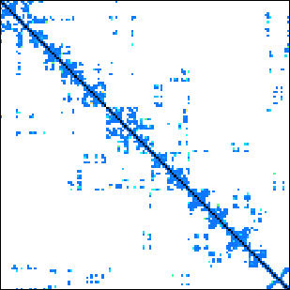
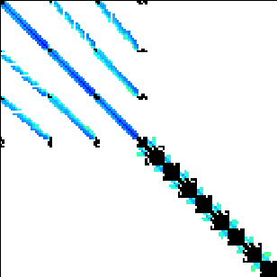
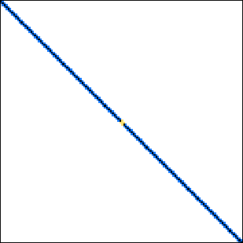
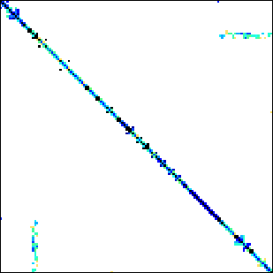
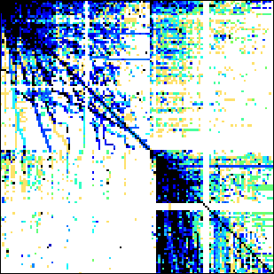
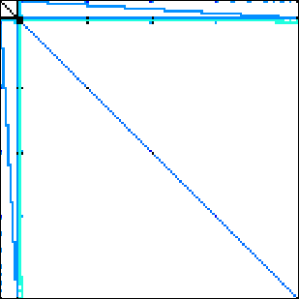
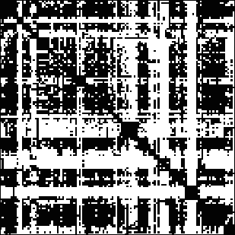
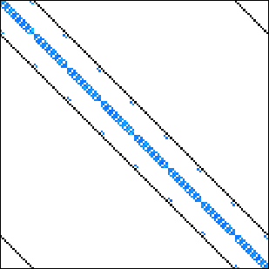

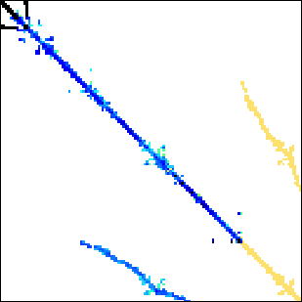
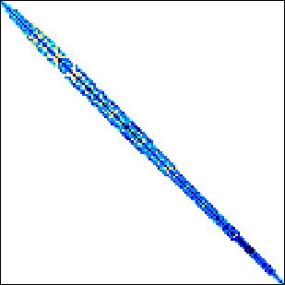

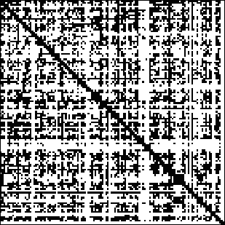
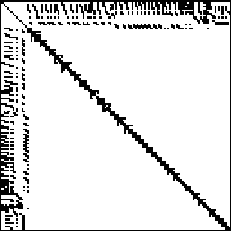
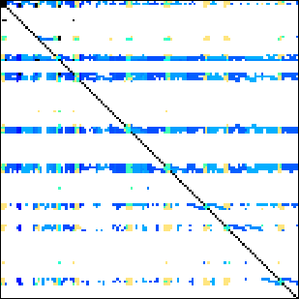
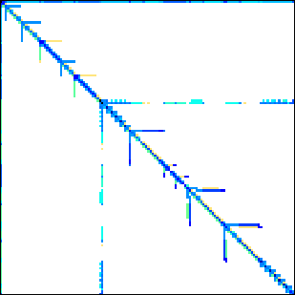
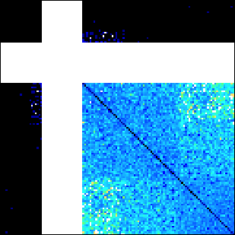
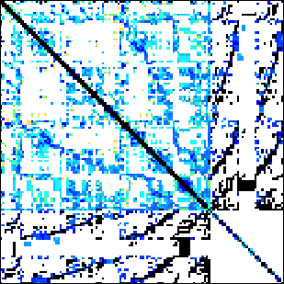
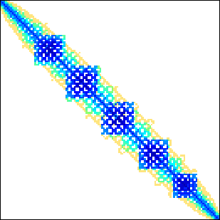
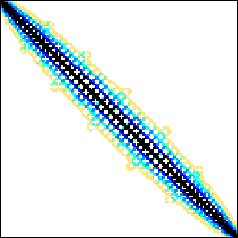
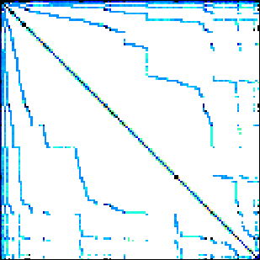
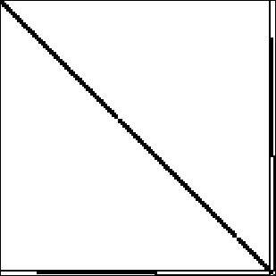
Benchmark suite
24 matrices downloadable from the University of Florida sparse matrix collection.
Dense
Protein
FEM/Spheres
FEM/Cantilever
Wind Tunnel
Webbase
LP
Circuit5M
eu-2005
QCD
Epidemiology
FEM/Harbor
FEM/Ship
Economics
in-2004
mip1
ASIC_680k
dc2
FEM/Accelerator
Circuit
Ga41As41H72
Si41Ge41H72
FullChip
ins2
14 regular matrices
10 irregular matrices

Slide 26
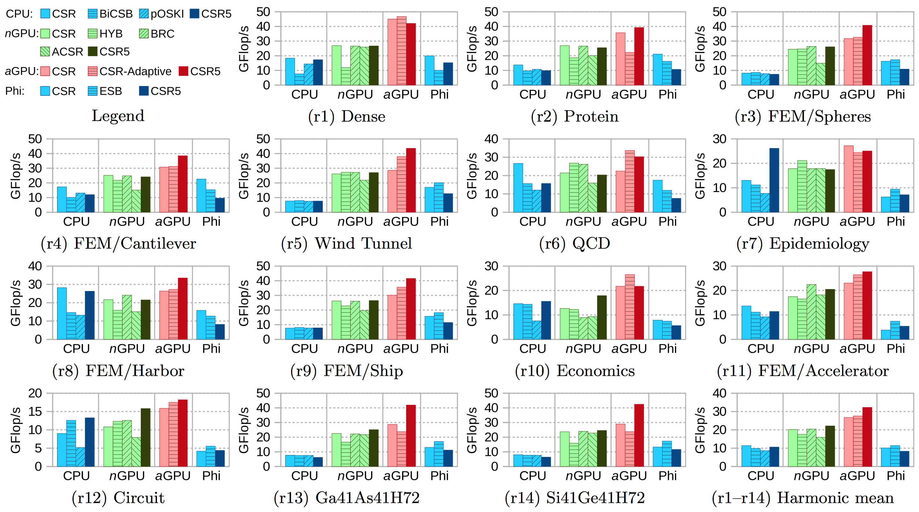
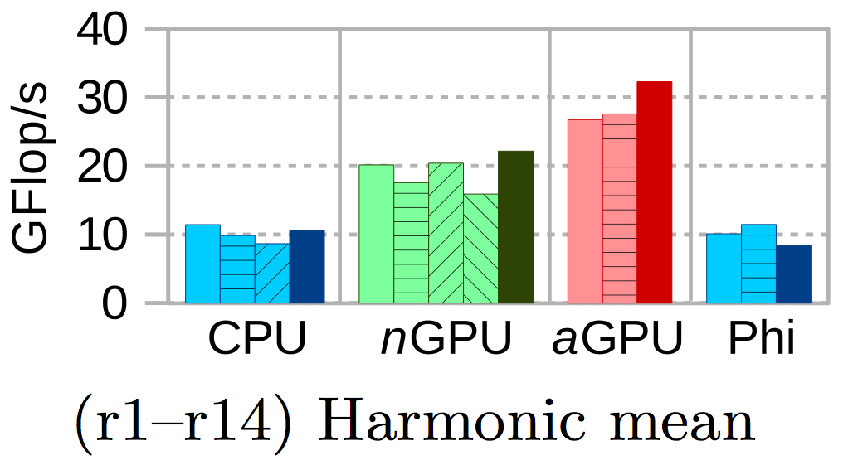
Throughput (FP64) – regular matrices

Slide 27
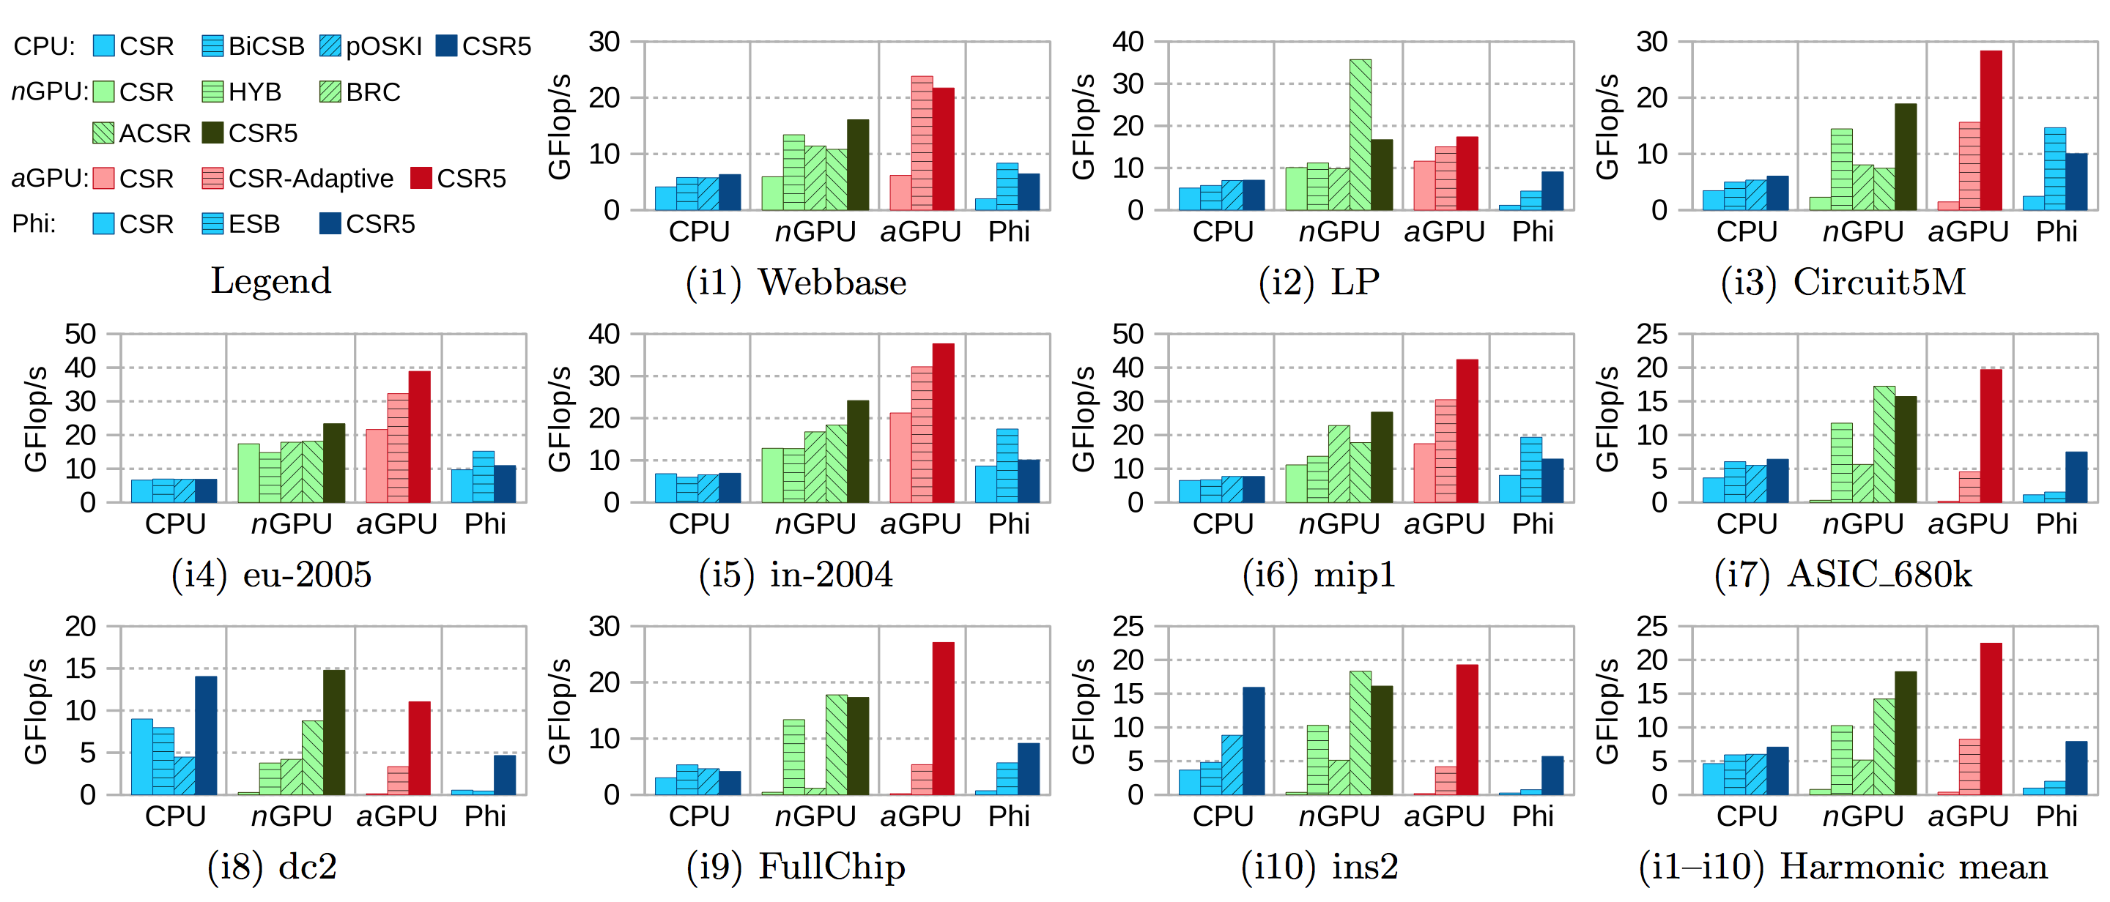
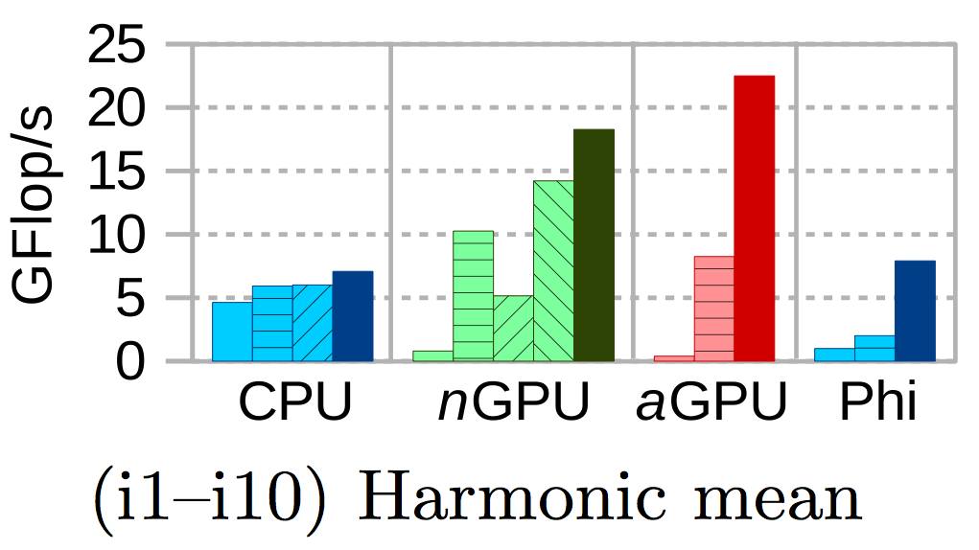
Throughput (FP64) – irregular matrices

Slide 28
Comparison with Recent Work
Faculty of Science

Slide 29
More Evaluation Criteria
We evaluate recently proposed formats with 6 criteria (extended from Langr and Tvrdik’s TPDS work):
SpMV Throughput (GFlop/s) for regular matrices,
SpMV Throughput (GFlop/s) for irregular matrices,
Format conversion overhead from CSR to new format,
Performance portability on mainstream devices,
Extra memory footprint for newly added data,
Auto-tuning of the used parameters.
D. Langr and P. Tvrdik. Evaluation Criteria for Sparse Matrix Storage Formats. IEEE TPDS, 2015.

Slide 30
CSR (baseline)
most widely-supported format
easy to produce
good performance for regular matrices
poor performance for irregular ones

Slide 31
HYB [SC ‘09]
modest performance for regular matrices
good performance for irregular ones
reasonable cost for format conversion
N. Bell and M. Garland. Implementing Sparse Matrix-Vector Multiplication on Throughput-Oriented Processors. SC ’09.

Slide 32
Cocktail (clSpMV) [ICS ‘12]
good performance for regular matrices
good performance for irregular ones
high cost for format conversion
single-precision only
B.-Y. Su and K. Keutzer. clSpMV: A Cross-Platform OpenCL SpMV Framework on GPUs. ICS ’12.

Slide 33
ESB [ICS ‘13]
good performance for regular matrices
weak performance for irregular ones
high cost for format conversion
Designed for Knights Corner Xeon Phi
adaptive auto-tuning
X. Liu, M. Smelyanskiy, E. Chow, and P. Dubey. Efficient Sparse Matrix-Vector Multiplication on x86-based Many-Core Processors. ICS ’13.

Slide 34
BCCOO/BCCOO+ (yaSpMV) [PPoPP ‘14]
great performance both for regular matrices and for irregular ones
very high cost for format conversion
nVidia-specific OpenCL code, by far
single-precision only
S. Yan, C. Li, Y. Zhang, and H. Zhou. yaSpMV: Yet Another SpMV Framework on GPUs. PPoPP ’14.

Slide 35
BRC [ICS ‘14]
good performance for regular matrices
weak performance for irregular ones
modest cost for format conversion
A. Ashari, N. Sedaghati, J. Eisenlohr, and P. Sadayappan. An Efficient Two-Dimensional Blocking Strategy for Sparse Matrix-vector Multiplication on GPUs. ICS ’14.

Slide 36
ACSR [SC ‘14]
slower than basic CSR for regular matrices
good performance for irregular ones
CUDA-specific on Kepler GPUs, by far
directly use CSR data
A. Ashari, N. Sedaghati, J. Eisenlohr, S. Parthasarathy, and P. Sadayappan. Fast Sparse Matrix-Vector Multiplication on GPUs for Graph Applications. SC ’14.

Slide 37
CSR-Adaptive [SC ‘14]
faster than basic CSR for regular matrices
weak performance for irregular ones
Performance-portable algorithms
directly use CSR data
J. L. Greathouse and M. Daga. Efficient Sparse Matrix-Vector Multiplication on GPUs using the CSR Storage Format. SC ’14.

Slide 38
CSR5 (this work) [ICS ‘15]
good performance both for regular matrices and for irregular ones
low cost for format conversion
share CSR data
support CPUs, nVidia/AMD GPUs and Xeon Phi
W. Liu and B. Vinter. CSR5: An Efficient Storage Format for Cross-Platform Sparse Matrix-Vector Multiplication. ICS ’15.

Slide 39
Conclusion
CSR5 is not sensitive to sparsity structure, thus delivers fast SpMV both for regular matrices and for irrgular matrices.
Format conversion from CSR to CSR5 is very fast (cost of a few SpMV operations).
CSR5 supports four mainstream platforms (CPUs, nVidia GPUs, AMD GPUs and Xeon Phi).
CSR5 gives speedups for scenarios with very few (tens of) iterations.

Slide 40
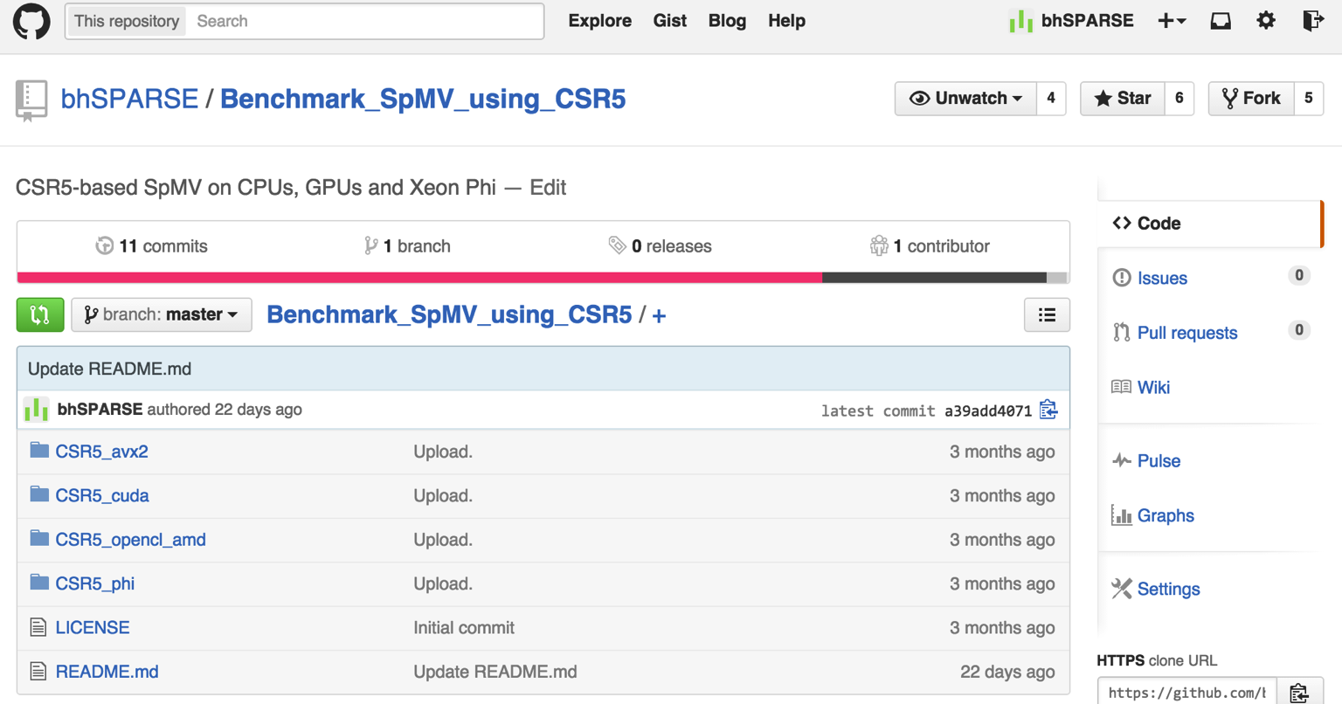
Source Code at Github
https://github.com/bhSPARSE/Benchmark_SpMV_using_CSR5

Slide 41
T k u !
A y Q s n s ?
0
4
8
9
0
2
4
7
11
12
13

Slide 42
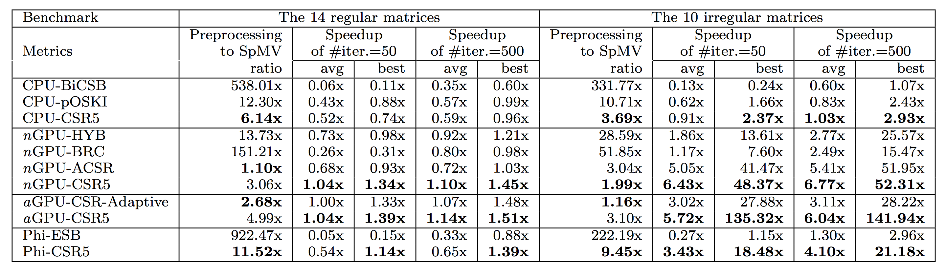
Format conversion cost and its impact
Better amortizing format conversion cost:
CSR5 can obtain speedups over CSR,
when only 50 iterations is required.

